Slide 1
A cognitive load delays predictive eye movements similarly during L1 and L2 comprehension
Department of Psychology, University of Edinburgh, Edinburgh, United Kingdom Faculty of Linguistics, Philology & Phonetics, University of Oxford, United Kingdom MARTIN CORLEY Department of Psychology, University of Edinburgh, Edinburgh, United Kingdom MARTIN J. PICKERING Department of Psychology, University of Edinburgh, Edinburgh, United Kingdom
6 March 2017
Özce Özceçelik
RPTU
Linguistic Lab Rotation
November 2023

Slide 2
Intro
It explores how cognitive resources, working memory, and language proficiency influence predictive processes during comprehension.
Eye tracking
the potential impact of cognitive load on the ability to make predictions during comprehension.
Visual World Eye-Tracking Paradigm
The hypothesis is that cognitive load may interfere with the ability to make predictions, with potential differences between L1 and L2 speakers.
Notes:
it explores how cognitive resources, working memory, and language proficiency influence predictive processes during comprehension. The use of eye-tracking technology in the visual world paradigm is a key methodology in understanding how people make predictions while processing language.
It discusses the potential impact of cognitive load on the ability to make predictions during comprehension.
Visual World Eye-Tracking Paradigm:
The authors employ the visual world eye-tracking paradigm as a methodology to investigate predictive eye movements during language processing. This involves tracking participants' eye movements as they listen to sentences and make predictions.

Slide 3
L1
L2
Research Question;
whether straightforward linguistic predictions, particularly those based on verb meaning in simple sentences, are affected by cognitive load.
Cognitive Load
Cognitive Load
if predictions rely on cognitive resources introducing a cognitive load, such as a ( working memory task), may delay or eliminate predictive eye movements.
No Cognitive Load
No Cognitive Load
Exp1
Exp2
semantic competitor effects
the pre-activation of semantic information and its relationship with cognitive resources.
due to potentially lower cognitive resources during L2 comprehension.
Notes:
The primary research question appears to be whether straightforward linguistic predictions, particularly those based on verb meaning in simple sentences, are affected by cognitive load.
The hypothesis suggests that if predictions rely on cognitive resources, introducing a cognitive load, such as a concurrent working memory task, may delay or eliminate predictive eye movements. Furthermore, the study aims to explore potential differences in the impact of cognitive load between L1 and L2 speakers, considering the possibility that L2 speakers may be more affected due to potentially lower cognitive resources during L2 comprehension.
The inclusion of semantic competitor effects underlines the interest in the pre-activation of semantic information and its relationship with cognitive resources. The study investigates semantic competitor effects, exploring whether participants pre-activate semantic information and if this process requires cognitive resources. This is assessed through the inclusion of semantically related distractors in the eye-tracking paradigm.

Slide 4
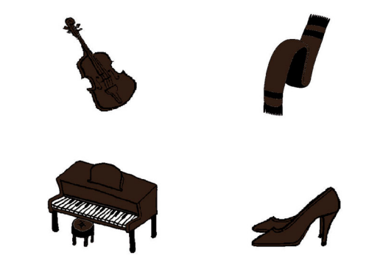
Exp1:Method
Stimuli
Auditory
16 sentence pairs
2 conditions
Visual
Predictable
UnPredictable
The lady will fold the scarf
The lady will find the scarf
1.3 syllables per second
The mean durations for the critical verbs and target nouns were 870 ms and 1098 ms respectively.
Notes:
The relatively slow speech was intended to create optimal conditions for predictive eye movements, such that any effects of load or population would be easy to observe.
The visual stimuli were 16 experimental displays, each with four objects, one depicted in each quadrant.
All the objects in a given display were presented in one of seven colours (grey, pink, purple, yellow, green, blue, and brown) in either a dark or a light shade.
Each of the target objects (e.g., scarf) was matched with a semantic competitor that was in the same semantic. category (e.g., high heels)
to prevent participants determining that the target object would be one that had a category coordinate in the array

Slide 5
Procedure
Cognitive Load Manipulation (Load Condition):
Participants in the load condition viewed five words together on the screen for eight seconds before the sentence and picture presentation. After a 500 ms blank screen, pictures were presented, and participants clicked on the corresponding picture.
They then listed the previously presented words within eight seconds.
Pictures were presented 1000 ms before sentence onset to provide participants with a preview.
No feedback
Experiment Duration:approximately 15–25 minutes.
Notes:
Participants clicked on the picture corresponding to the final word in the sentence. In the load condition, they additionally listed the words presented earlier.
No feedback was provided during the experiment. The mouse pointer's position was corrected to the center of the screen after each trial.
Experiment Duration:
The experiment began with two practice trials and lasted approximately 15–25 minutes.

Slide 6
Results
Behavioral Task accuracy
No-load condition not recorded-load condition 100%
Eye-Tracking data analyses;
Two linear mixed-effects models were constructed to evaluate the log-transformed fixation probabilities. The models included fixed effects for predictability (predictable vs. unpredictable), load (no-load vs. load), and the interaction of predictability by load.
Notes:
Dependent Variables:
The eye-tracking data were analyzed, focusing on the proportion of time spent fixating on target objects and semantic competitor objects.
Time Bins:
The data were analyzed in small time intervals (50 ms bins) relative to the onset of the target noun, covering a specific time range from 1500 ms before to 500 ms after the target word onset.
Log Odds Transformation:
Fixation probabilities were transformed into log odds using the empirical logit function. This transformation is commonly used in logistic regression to stabilize variance and make the data more amenable to statistical modeling.
Linear Mixed-Effects Models:
Two linear mixed-effects models were constructed to evaluate the log-transformed fixation probabilities. The models included fixed effects for predictability (predictable vs. unpredictable), load (no-load vs. load), and the interaction of predictability by load. Random intercepts were included for both participants and items.
Random Slopes:
Random slopes were not included for load because they are not appropriate for between-subject factors. Random slopes for predictability and the predictability by load interaction were not included due to convergence issues.
Time-Course Analysis:
The time-course analysis involved running the models for every 50 ms bin within the specified time range. This approach helps examine the dynamic changes in fixation probabilities over time.

Slide 7
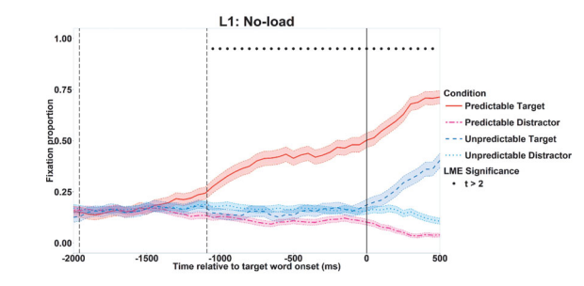
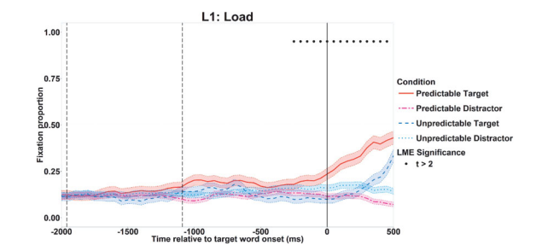
Effects of Prediction and Load
Notes:
Figure 2 shows fixation probabilities on target objects and mean fixation probabilities on distractor objects in the predictable and unpredictable conditions,
separately for the load condition and for the no-load condition.
(The time was synchronised to target noun onset, with verb onset and offset being the means of all the critical items. )The graphs show the time window from 2000 ms before to 500 ms after the target noun onset.
Visual inspection of the graphs suggests that differences in the fixation proportions on target objects in the predictable versus the unpredictable condition began to emerge later in the load condition than in the noload condition. In support of this, the linear mixed-effects model showed an interaction of predictability by load (|t|s > 2) in every 50 ms window from 1000 ms before the target noun onset until 500 ms after the target noun onset. The interactions indicate indicate that predictive eye movements were delayed by load.
As the upper panel of Figure 2 indicates, participants in the no-load condition were more likely to look at target objects in the predictable condition than in the unpredictable condition from 1050 ms before the noun onset onwards (shown as • in Figure 2)
The result suggests that participants in the noload condition predicted upcoming objects that were predictable. As the lower panel of Figure 2 shows, participants in the load conditions were also more likely to look at target objects in the predictable condition than in the unpredictable condition, but this effect did not emerge until 250 ms before the target noun onset. To sum up, the analyses show that predictive eye movements occurred in both conditions, but that they began about 800 ms earlier in the no-load than in the load condition

Slide 8
Discussion
Experiment 1 investigated whether making successful predictive eye movements during language comprehension is affected by cognitive load.
They found that predictive eye movements in L1 speakers occurred whether or not those speakers were faced with the additional cognitive load.
However, the cognitive load led to those predictive eye movements being delayed.
Notes:
Experiment 1 investigated whether making successful predictive eye movements during language comprehension is affected by cognitive load. We found that predictive eye movements in L1 speakers occurred whether or not those speakers were faced with the additional cognitive load. However, the cognitive load led to those predictive eye movements being delayed. It seems that the additional load caused participants to have fewer cognitive resources that could be allocated to making predictive eye movements.
Experiment 1 wanted to see if understanding language and predicting what comes next is harder when we have to remember things at the same time. What they discovered was that people are still able to predict what's coming in a sentence, even when they have to remember other things. However, when they have to remember things, the predicting part takes a bit longer. It looks like trying to remember things at the same time makes it a bit harder for our brains to quickly figure out what's coming next in a sentence.

Slide 9
Exp 2:
L2 speakers of English.
whether predictive eye movements in L2 speakers occurred under conditions of load and no load, and whether load caused any predictive eye movements to be delayed.
Given the results of Experiment 1, they hypothesised that predictive eye movements in L2 speakers would also be delayed under load.
Alternatively, L2 speakers may not make predictive eye movements at all under load, due to fewer resources available during L2 comprehension.
Notes:
Experiment 2 addressed similar questions to Experiment 1, but used L2 speakers of English. It asked whether predictive eye movements in L2 speakers occurred under conditions of load and no load, and whether load caused any predictive eye movements to be delayed. Given the results of Experiment 1, we hypothesised that predictive eye movements in L2 speakers would also be delayed under load. Alternatively, L2 speakers may not make predictive eye movements at all under load, due to fewer resources available during L2 comprehension.

Slide 10
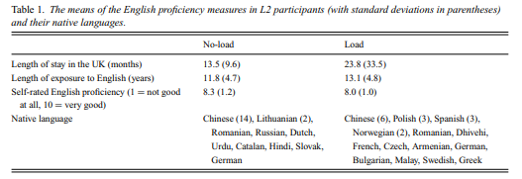
Exp 2:Method
They filled in a language background questionnaire before the experiment.
Notes:
L2 participants in the no-load and load conditions did not differ on any of these measures, ps > .15.
Stimuli and procedure The stimuli and the procedure in Experiment 2 were identical to those in Experiment 1.

Slide 11
Retults
Behavioural task accuracy
No-load condition not recorded-load condition 98%
The eye-tracking data were analysed as in Experiment 1.

Slide 12
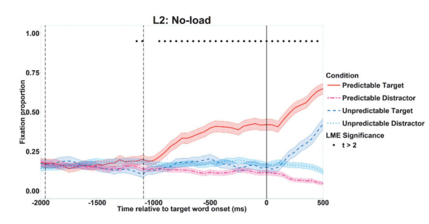
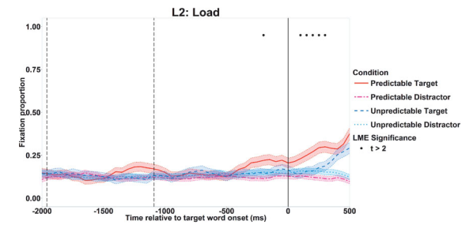
Effects of Prediction and Load
Notes:
Figure 3 shows the fixation probabilities on target objects and the averaged fixation probabilities on distractor objects in the predictable and in the unpredictable conditions for participants in the load condition and in the no-load condition separately.
The significant interactions in the time window before target word onset indicate that participants showed more predictive eye movements when they were not under cognitive load than when they were under cognitive load.
Participants in the no-load condition were more likely to look at target objects in the predictable condition than in the unpredictable condition from 1150 ms to 1050 ms before the target word onset, and from 950 ms before the target word onset onwards (shown as • in Figure 3)
. In contrast, participants in the load condition did not show a significant effect of predictability in consecutive bins until 100 ms after the target word onset. As in Experiment 1, we can conclude that predictability effects on eye movements were significantly delayed as a result of the additional cognitive load.

Slide 13
Discussion
Participants who performed the concurrent working memory task showed increased looks to predictable objects much later compared to those who did not perform the working memory task.
This pattern of results was similar for L1 and L2 participants.
predictive eye movements use some of the cognitive resources that are used for remembering words.
No semantic competitor effects
Evidence for predicting L2;
Syntactically simple,types of cues,speeh rate and proficiency
Participants variance
Notes:
Participants who performed the concurrent working memory task showed increased looks to predictable objects much later compared to those who did not perform the working memory task. This pattern of results was similar for L1 and L2 participants. Taken together, the results suggest that predictive eye movements draw on some of the cognitive resources that are used for remembering words.
They found no evidence that semantic competitor objects were more likely to be fixated than distractors. two distractors were semantically related to each other as well as target and semantic competitor objects were to each other, whereas the distractors were semantically unrelated in other studies (Huettig & Altmann, 2005; Yee & Sedivy, 2006).
Finally, our L2 participants differed in their L1, unlike the previous studies on L2 prediction (Chambers & Cooke, 2009; Dijkgraaf et al., 2016; Mitsugi & MacWhinney, 2016). It might be that L2 participants whose L1 was more similar to English showed more predictive eye movements than L2 participants whose L1 was less similar.

Slide 14
Conclusion
two experiments to explore if there are limitations in how both native (L1) and non-native (L2) speakers make predictions during language comprehension.
This suggests that the cognitive resources used for predicting eye movements overlap with those used for remembering words.
no fundamental differences in how cognitive load influences predictive eye movements between L1 and L2 speakers.
the underlying mechanisms of prediction are similar in both native and non-native language comprehension.
Notes:
The study conducted two experiments to explore if there are limitations in how both native (L1) and non-native (L2) speakers make predictions during language comprehension. The findings indicated that both L1 and L2 speakers exhibited similar predictive eye movements, but these movements were delayed when participants simultaneously performed a working memory task of remembering words. This suggests that the cognitive resources used for predicting eye movements overlap with those used for remembering words.
The conclusion drawn is that making predictive eye movements involves cognitive processes related to word memory, and these processes are affected when cognitive resources are concurrently engaged in a memory task. Importantly, the study found no fundamental differences in how cognitive load influences predictive eye movements between L1 and L2 speakers. This supports the idea that the underlying mechanisms of prediction are similar in both native and non-native language comprehension.

Slide 15

Thanks for listening

Slide 16
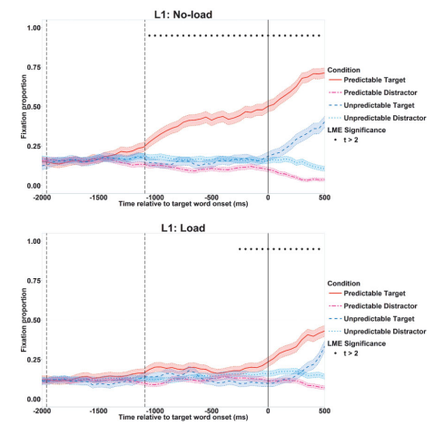
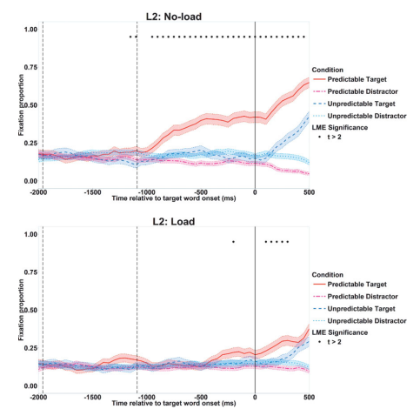
Notes:
unlike in L1 participants cognitive load affects both predictive and unpredictive targets.
, cognitive load did not influence the identification of target objects in the unpredictable condition in L2 participants.
Is it related to the choice of distractors or does it indicate a difference between L1 and L2?

